Slide 1
OBESITY PROJECT-FINAL PROJECT-2023-Abed Sanchez-CORRECTED-FLOW-040523
File created on: 12/10/2023 2:51:46 PM

Slide 2
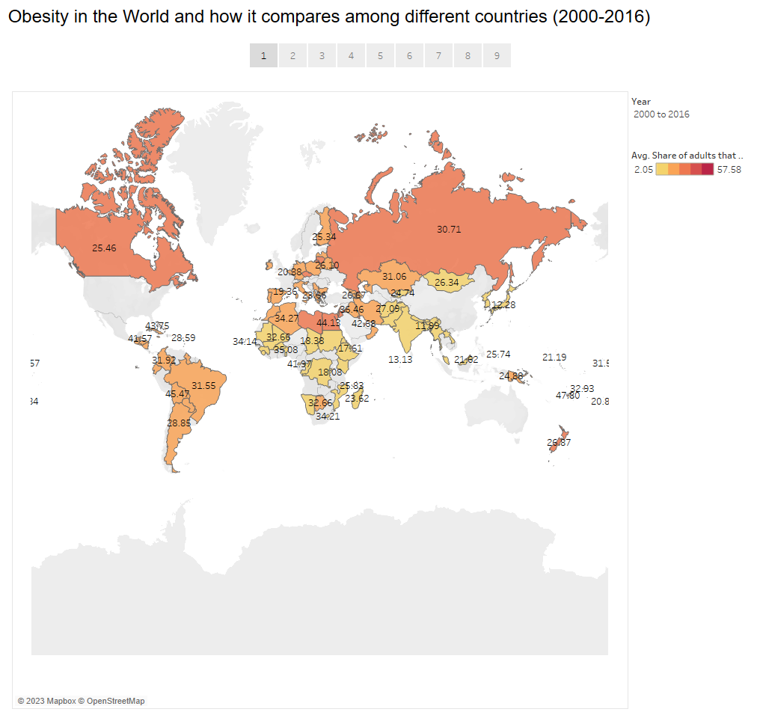

Slide 3
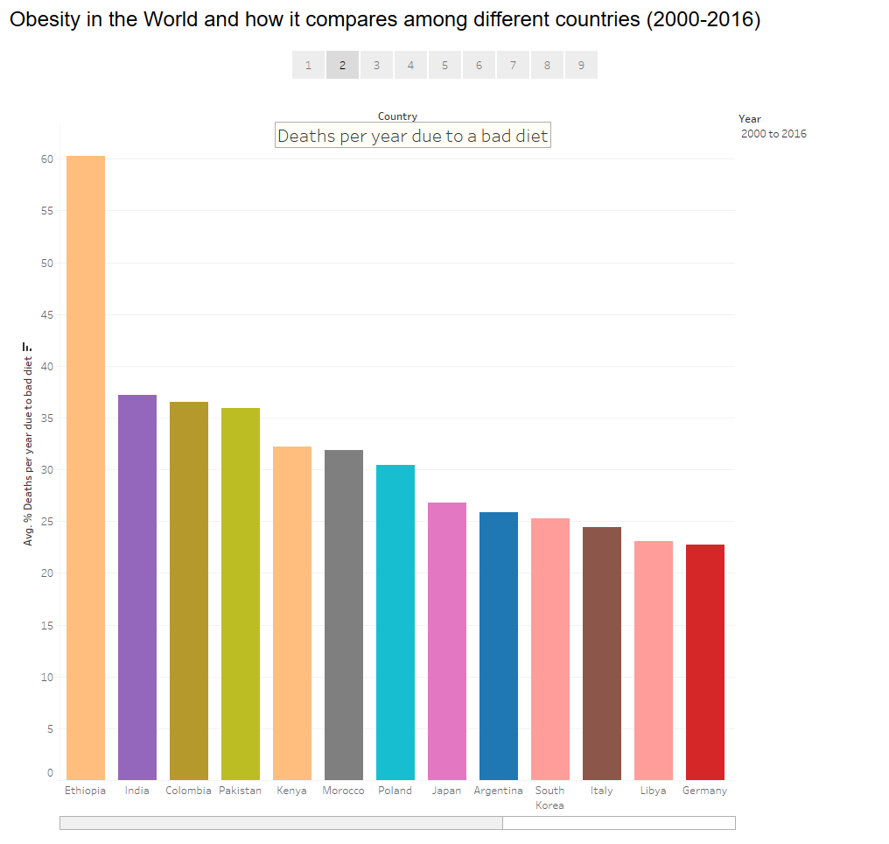

Slide 4
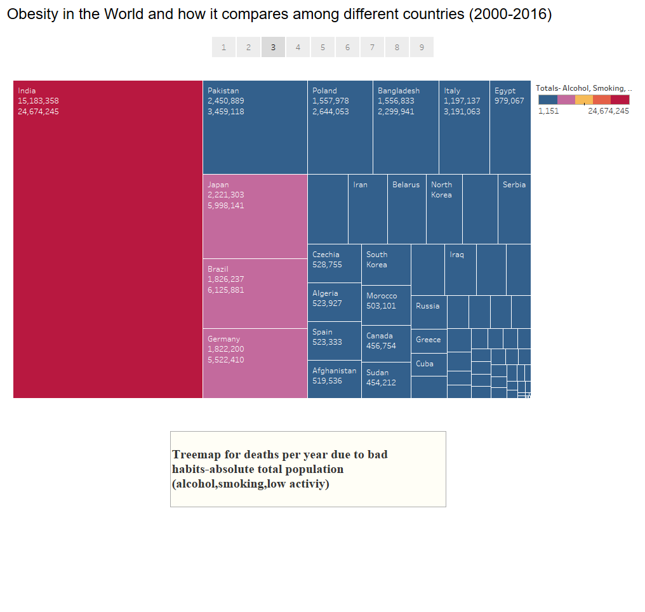

Slide 5
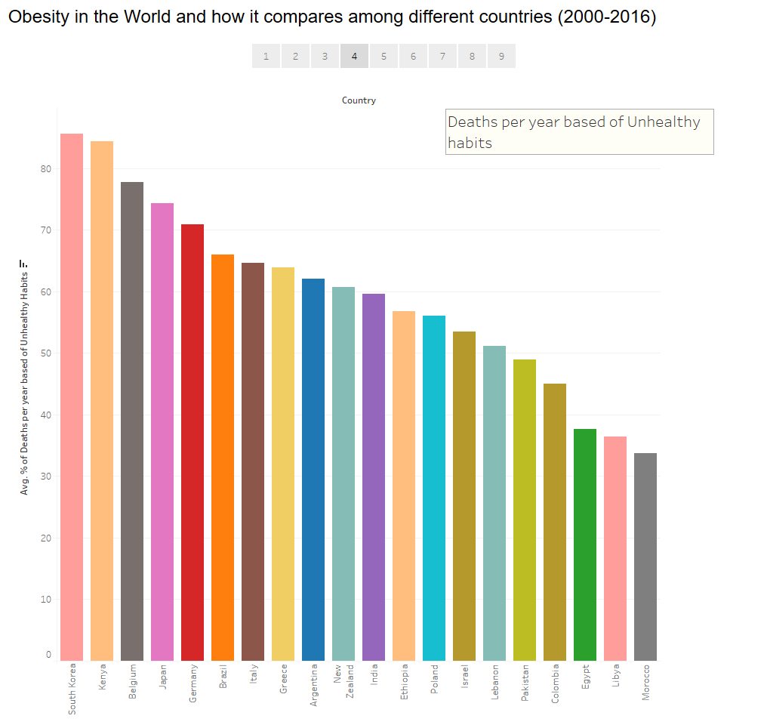

Slide 6
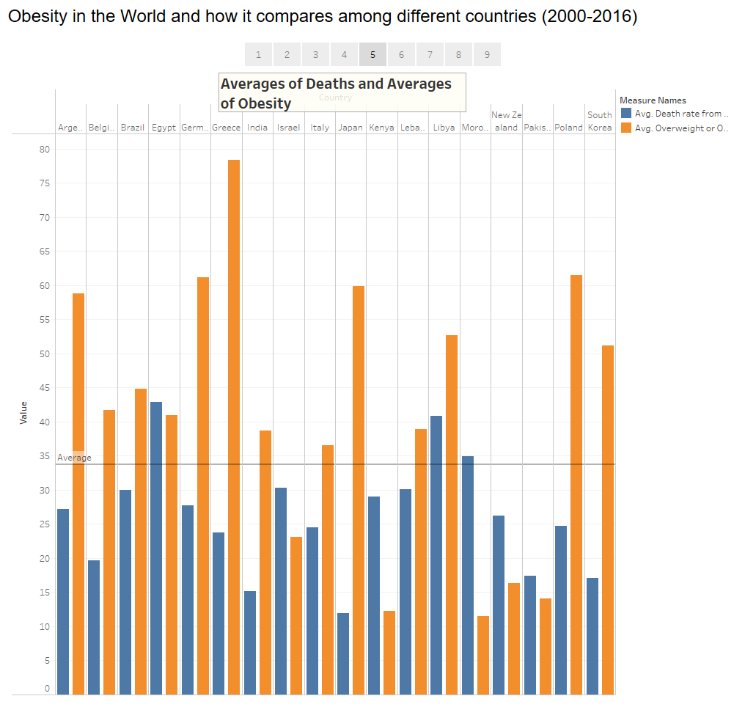

Slide 7
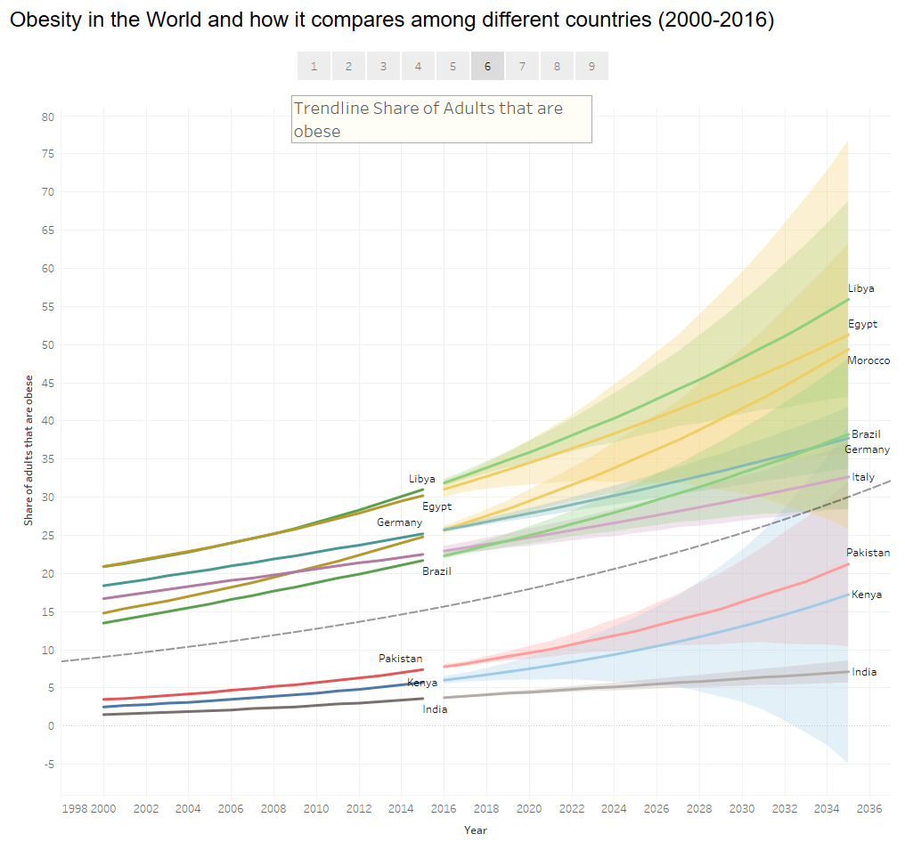

Slide 8
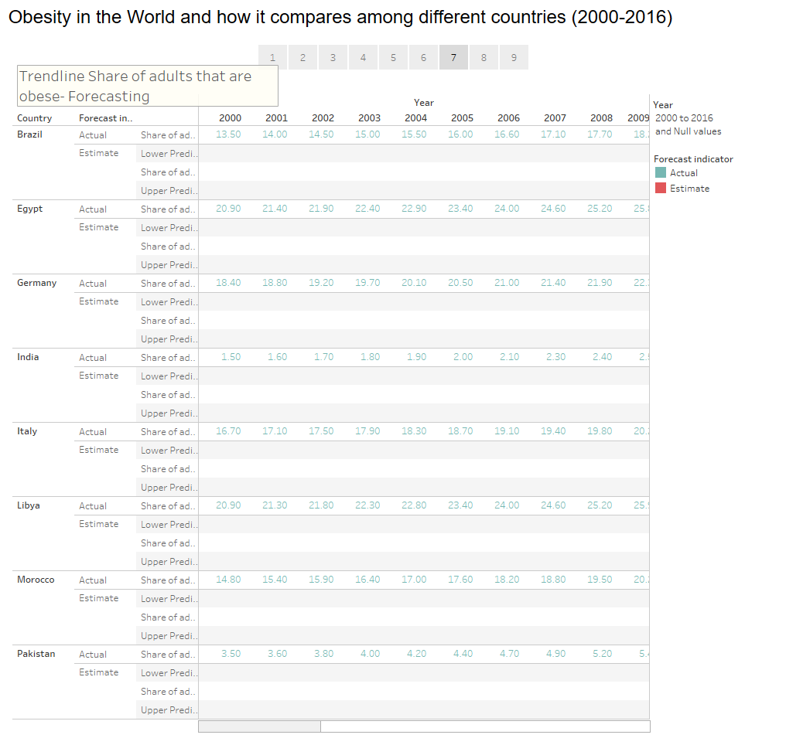

Slide 9


Slide 10
